Slide 1
Vmware Player
At first glance
Made by CreaTish

Slide 2
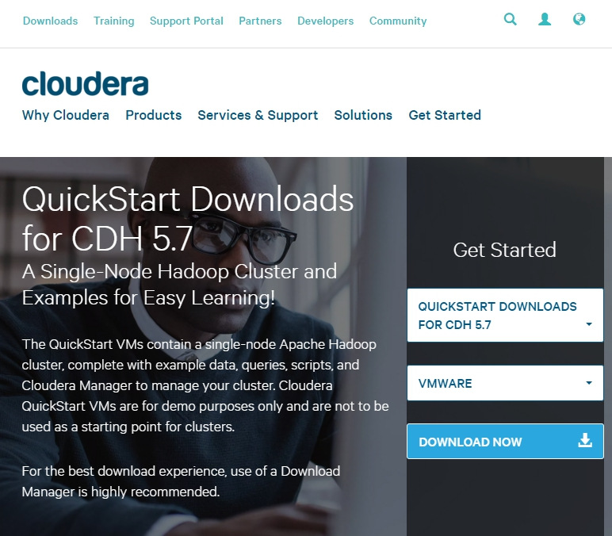
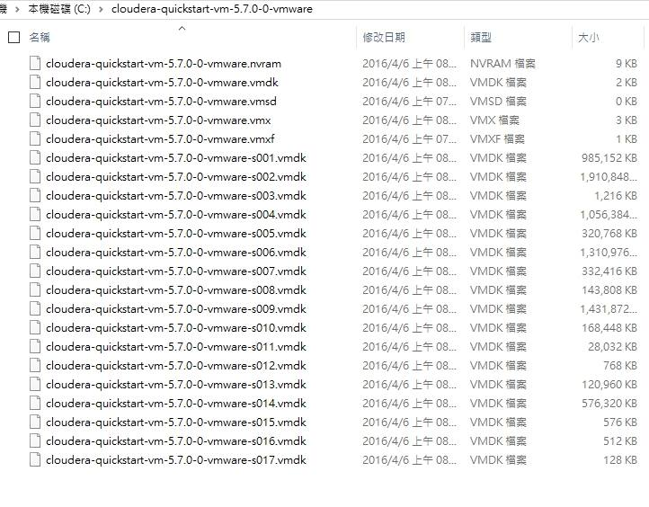
Download Cloudera QuickStart VM
http://www.cloudera.com/downloads/quickstart_vms/5-7.html

Slide 3
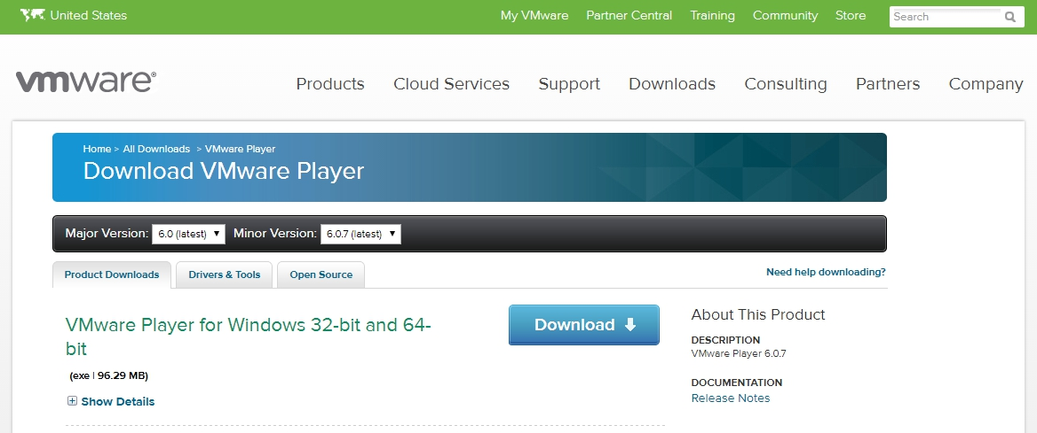
Download VMware Player
Download and setup VMware Player
https://my.vmware.com/web/vmware/free#desktop_end_user_computing/vmware_player/6_0

Slide 4
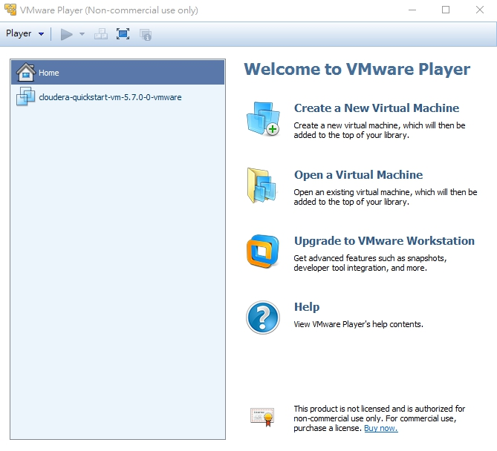
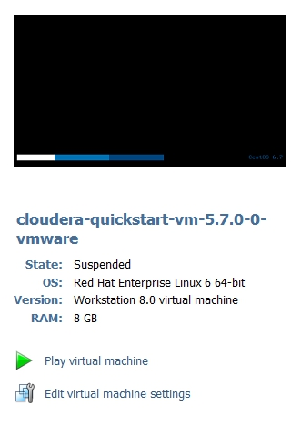
Display VMware Player & open cloudera quickstart VM
open “VMware Player.exe” and click to open cloudera quickstart VM
Click!
remember to set the memory at least 8GB

Slide 5
Get Started
HUE (Hadoop User Experience)
- 用於數據分析的Apache Hadoop的web窗口。
Cloudera Manager
- Cloudera Manager是Cloudera為了Hadoop出的管理工具。
Cloudera Manager無法運行的原因可能是記憶體不足，Cloudera Manager要求至少8GB的RAM以及2個virtual CPUs。
5

Slide 6
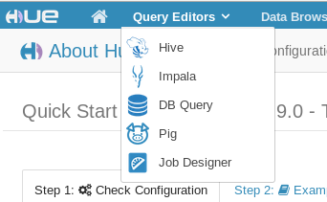
Query Editors
Hive
- 基於Hadoop的一個數據倉庫工具。
Impala
- 跑在Hadoop架構上的互動SQL查詢引擎。
DB query
- 資料庫查詢。
Pig
- 基於Hadoop的大規模數據分析平台。

